Slide 1
HOW TO TEACH THE BAND
(and by band, I mean the kids who don’t play instruments… the Color Guard)
Presented by Chris Moss
2014 SCMEA In-Service Convention

Slide 2
Why are we here?
SCMEA 2014
Many band programs and their directors are finding color guard classes within their daily schedules.
Who teaches these classes?
How should a guard class be structured on a daily and long-term basis?

Slide 3
Why Color Guard class?
SCMEA 2014
The most obvious reason: MORE REHEARSAL TIME!!!
If “band” is offered every day, then guard should be as well.
If “band” is offered year-round, then guard should be as well.
How is guard class different than a normal rehearsal?

Slide 4
Teaching (not cleaning ) Color Guard
SCMEA 2014

Slide 5
What makes a great Color Guard?
SCMEA 2014
The WHAT
The HOW

Slide 6
Why is dance training so important?
SCMEA 2014

Slide 7
Technique Training vs. Choreography
SCMEA 2014
Every note… every rhythm…
Every body position… every equipment technique…

Slide 8
Adapting the National Standards
SCMEA 2014
Singing, alone and with others, a varied repertoire of music.
Performing on instruments, alone and with others, a varied repertoire of music.
Dancing, alone and with others, a varied repertoire of dance styles.
Performing on all pieces of equipment, alone and with others, a varied repertoire of choreography.

Slide 9
Adapting the National Standards
SCMEA 2014
Improvising melodies, variations, and accompaniments.
Composing and arranging music within specified guidelines.
Reading and notating music.
Improvising simple combinations and phrases.
Writing choreography within specified guidelines.
Learning and translating choreography.

Slide 10
Adapting the National Standards
SCMEA 2014
Listening to, analyzing, and describing music.
Evaluating music and music performances.
Understanding relationships between music, the other arts, and disciplines outside the arts.
Watching, analyzing, and describing performances.
Evaluating color guard performances.
Understanding relationships between color guard and the other arts.

Slide 11
Adapting the National Standards
SCMEA 2014
Understanding music in relation to history and culture.
Understanding dance and music in relation to history and culture.

Slide 12
In Color Guard, do students learn about music?
SCMEA 2014
Perhaps that’s not the right question…
Does our color guard class TEACH students about music?

Slide 13
PLANNING FOR DAILY CLASSES
SCMEA 2014

Slide 14
How are classes divided?
SCMEA 2014
Equipment Day
Dance Day

Slide 15
Traditional Band Rehearsal Topics
SCMEA 2014
Breathing
Long Tones
Articulation
Scales and Arpeggios
Chorales and Etudes
Musical Repertoire

Slide 16
Breathing
SCMEA 2014
DANCE – Breathing Exercises
FLAG – Moving Spins
WEAPON – Moving Spins

Slide 17
Long Tones
SCMEA 2014
DANCE – Port de Bras (Barre class)
FLAG – Drop Spins
WEAPON – Spins (Traditional and Non-Traditional)

Slide 18
Articulation
SCMEA 2014
DANCE – Leg Articulation
FLAG – Pull Hits
FLAG – Cones
WEAPON – Catching Exercises
WEAPON – Flourishes

Slide 19
Scales and Arpeggios
SCMEA 2014
DANCE – Adagio (Port de Bras and Leg Articulation)
FLAG – Tosses
WEAPON – Tosses

Slide 20
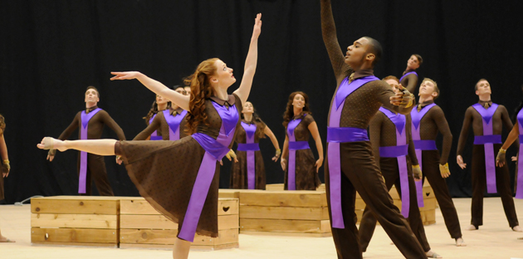
Chorales and Etudes
SCMEA 2014
DANCE – Across the Floor and Combinations
FLAG – Across the Floor and Combinations
WEAPON – Across the Floor and Combinations

Slide 21
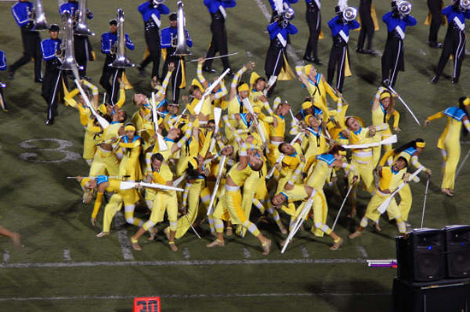
Musical Repertoire
SCMEA 2014
Choreography

Slide 22
LONG TERM PLANNING
SCMEA 2014

Slide 23
Yearly Plan
SCMEA 2014
Post Band Camp / Early Marching Band
Competition Season
TWO WEEKS OF FUN!!!
Winter Training
Winter Competition Season
Design Projects
More FUN!!! And Auditions

Slide 24
Additional Materials
Clinic Notes
Educational Videos List
Jen’s Music List

